Slide 1
A Family Friendly Card Game
Team 5: Antonio, Mikayla, Michael, Alec, Andrew

Slide 2
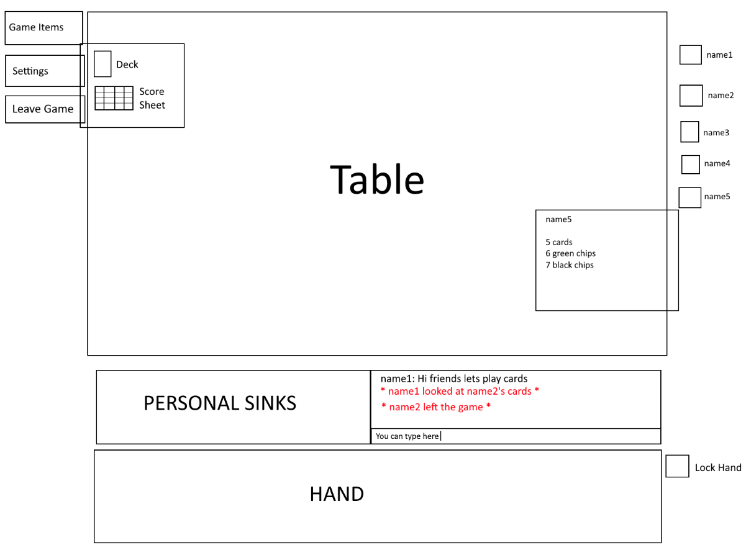
Original Scope and Objectives

Slide 3
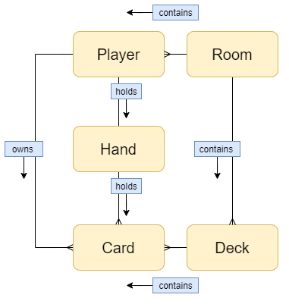
Approach: Structural Design Focused
Strengths: Data modeling & Backend development
Build a service, not an application
Backend first
Enable concurrent workflow
Organization
Notes:
Mikayla
Early Planning
Flexible Components
React

Slide 4
Agile Development
3 Meetings Per Week
Monday kickoff/retro
Wednesday/Friday standup
One-week sprints
Weekly Role Rotation
Scrum master
Product owner
Pivotal Tracker
Pointing Stories
Re-adjustments
Notes:
Michael

Slide 5
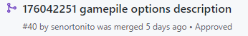
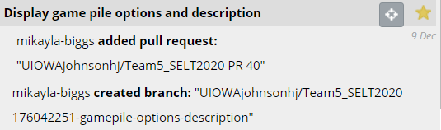
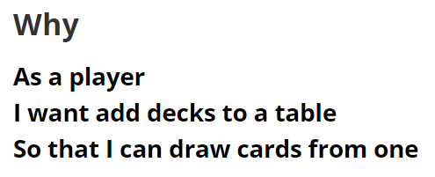
Branches, PR’s, User Stories, and Approvals
Pivotal Tracker Integration
Formatted Github Branches
Pull Requests
At least 2 approvals before merging
Code conflicts were limited
Subject Matter Expert (SME)
Divided Specialized Knowledge
Pair Programming

Slide 6


Coverage & Testing
TDD
98.63% Coverage
BDD
Capybara
Used for Pre-JS implementation
Dealt with redundancy of tests
Jest
Post-JS integration testing framework
Cucumber
Gherkin
Notes:
Andrew

Slide 7
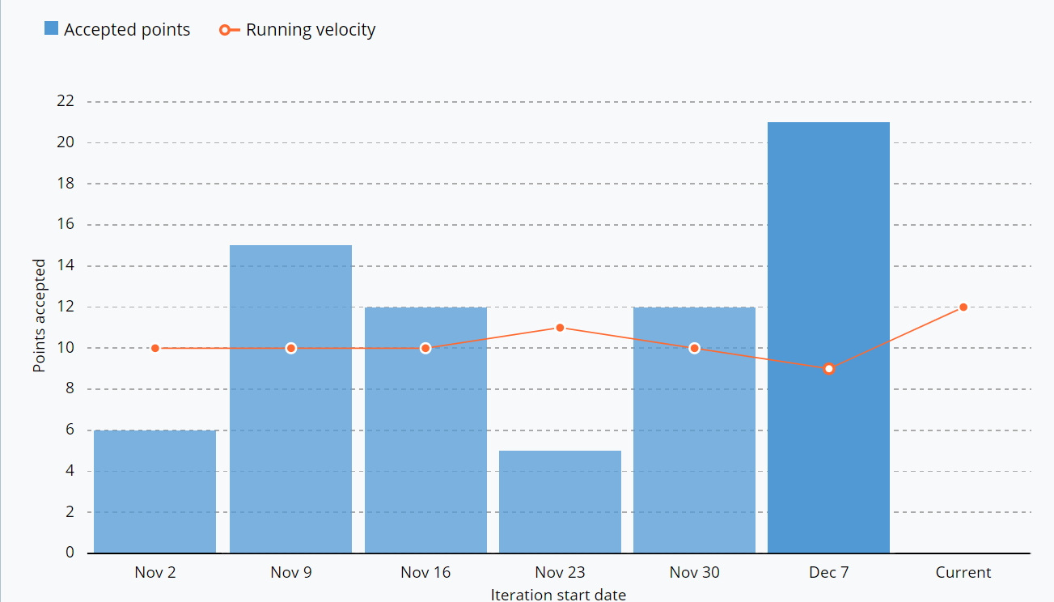
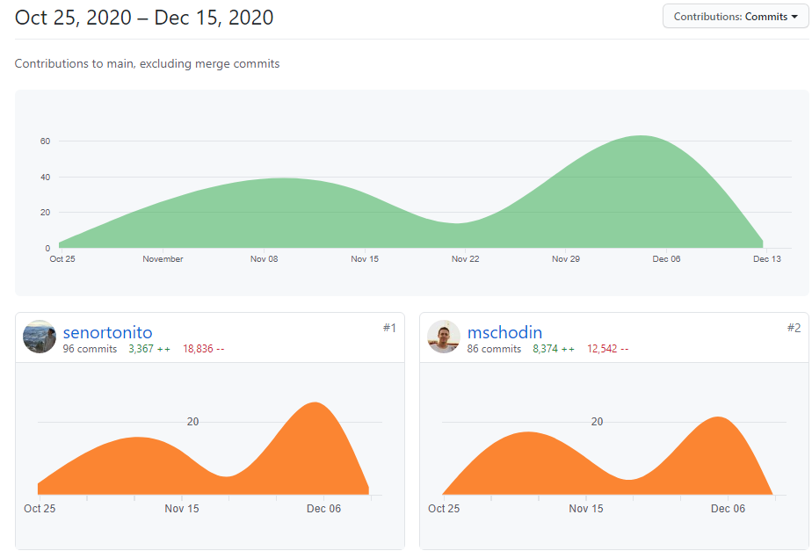
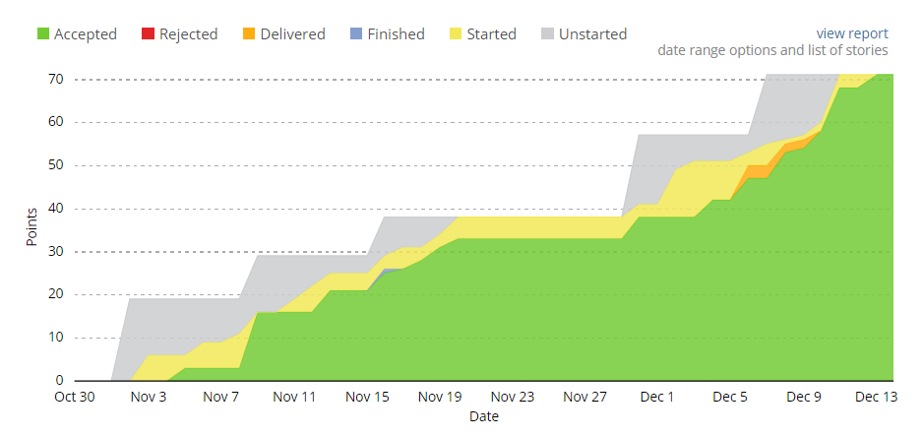

Slide 8
Roadblocks and Growth
Routing
Blockers For User Stories
Implementing New Frameworks
Team Motivation Throughout the Week
Pair Programming

Slide 9
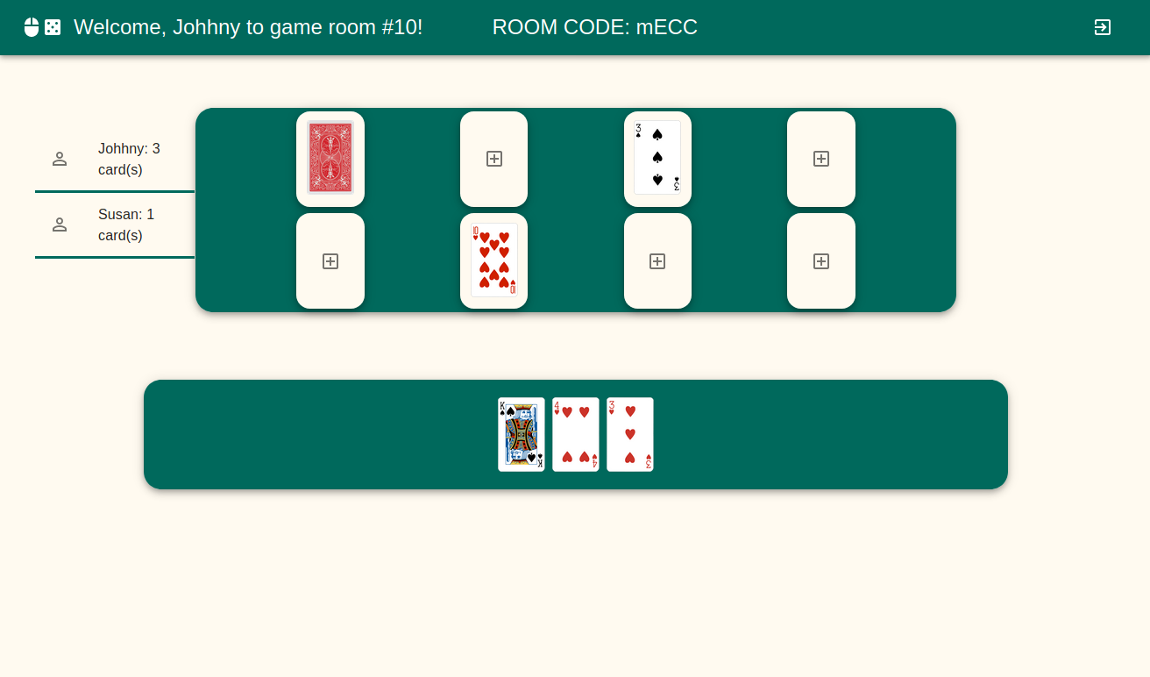

Slide 10
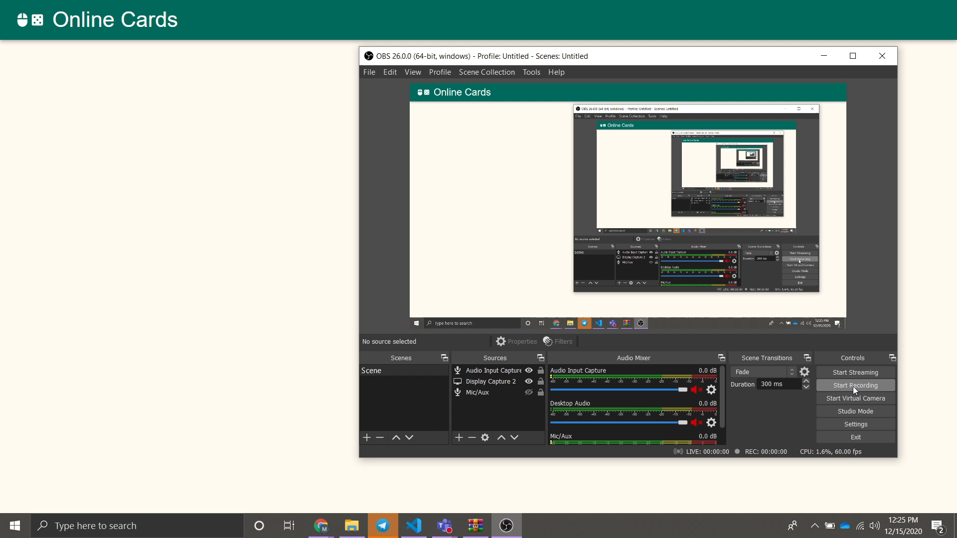
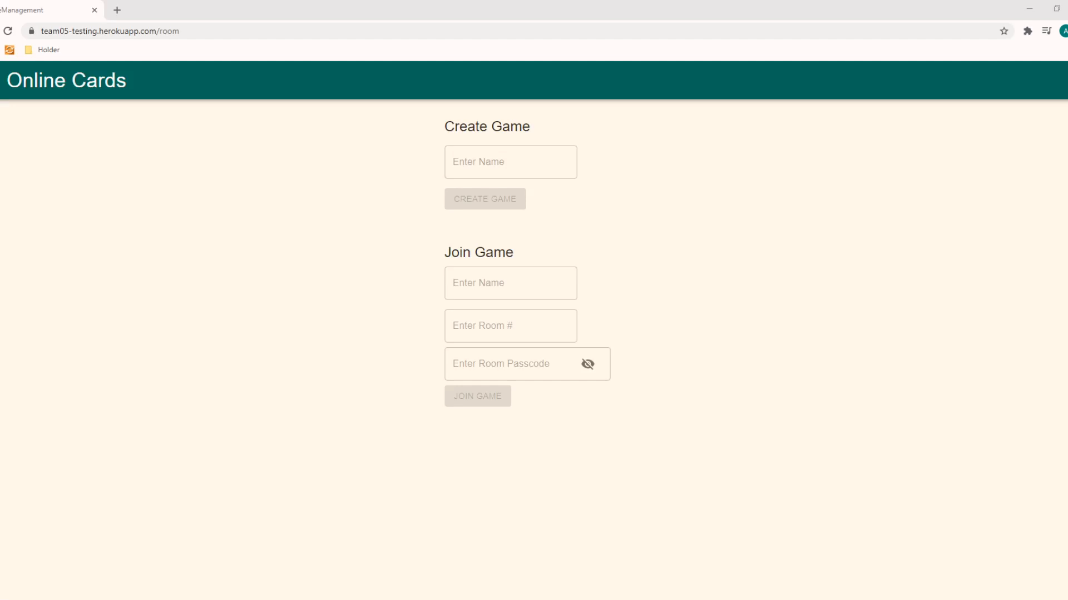
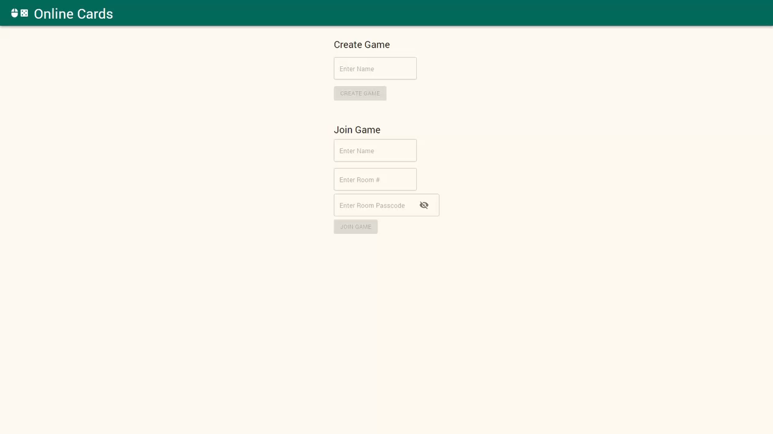
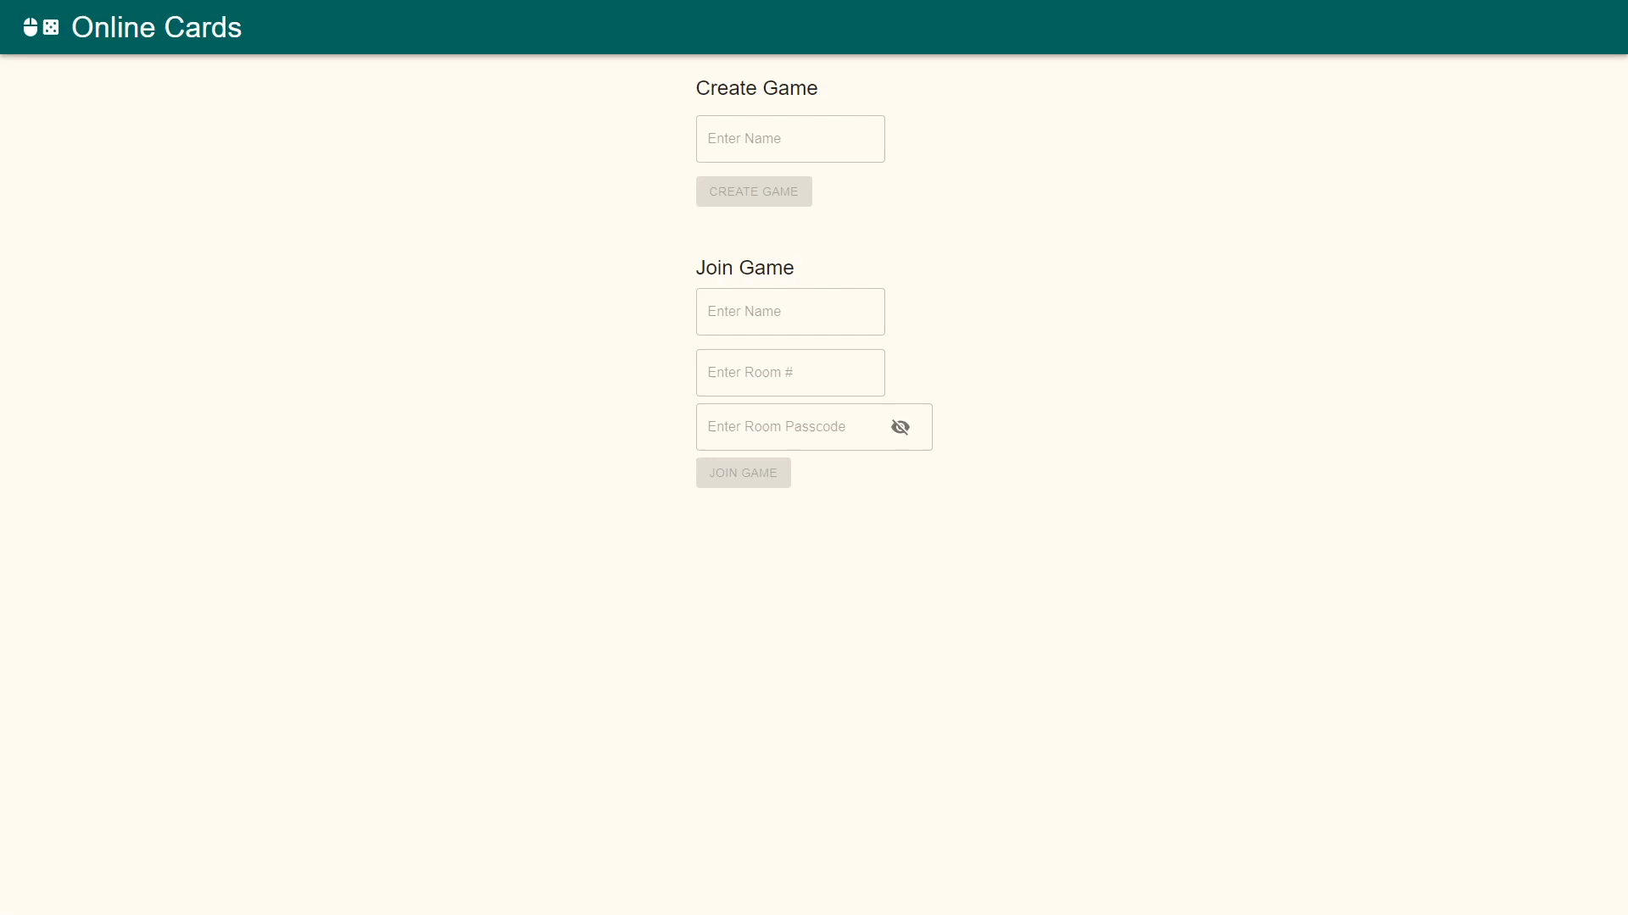
Notes:
Alec

